Slide 1


Slide 2


Student Performance Prediction Using Educational Data Mining Techniques
Final Year Project Synopsis
Submitted by
ROLL | NAME
2301840009 | Mansi Rawat
2301840005 | Sahil Parasar
Faculty Mentor: Dr. Meenu
Notes:
New Courses replaced with New Programmes

Slide 3
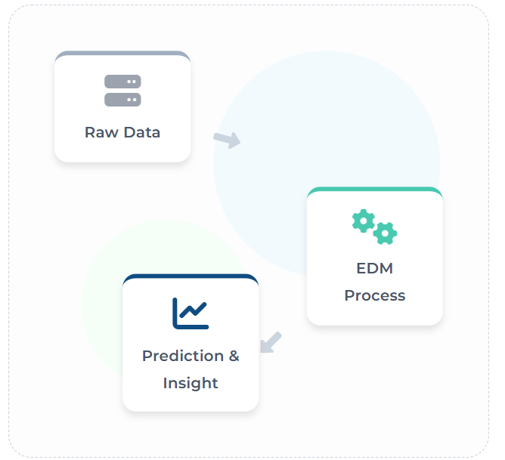

Project Overview
The Data Challenge
Educational institutions accumulate vast amounts of data (grades, attendance, logs) that remain largely underutilized for strategic decision-making.
Reactive vs. Proactive
Traditional methods identify struggling students only after failure occurs. There is a critical need for early, data-driven detection.
The Solution: EDM & ML
Educational Data Mining (EDM) and Machine Learning can analyze complex patterns to predict academic outcomes with high accuracy.
Project Goal
Build a predictive system to forecast student grades (A–F) and provide actionable insights for timely teacher intervent
Notes:
New Courses replaced with New Programmes

Slide 4
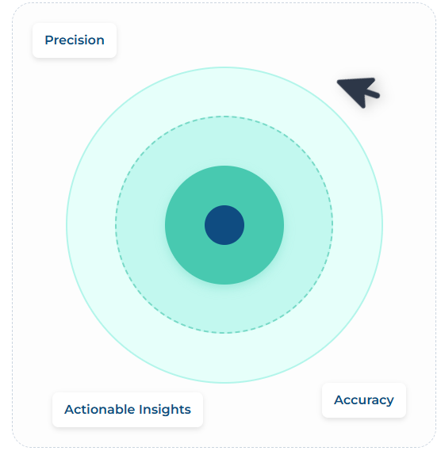
Specific Objectives
Analyze Datasets
Analyze educational datasets using advanced data mining techniques to understand data structure.
Predict Performance
Predict student academic performance (A–F) using supervised machine learning models.
Compare Algorithms
Compare multiple classification algorithms (Logistic Regression, Decision Tree, RF, SVM).
Identify Key Factors
Identify critical factors affecting student performance such as attendance and study habits.
Early Warning System
Provide an automated early warning system to assist educators in timely interventions.
Notes:
New Courses replaced with New Programmes

Slide 5
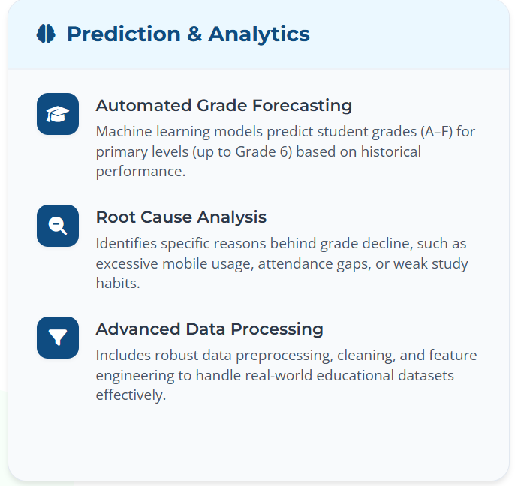
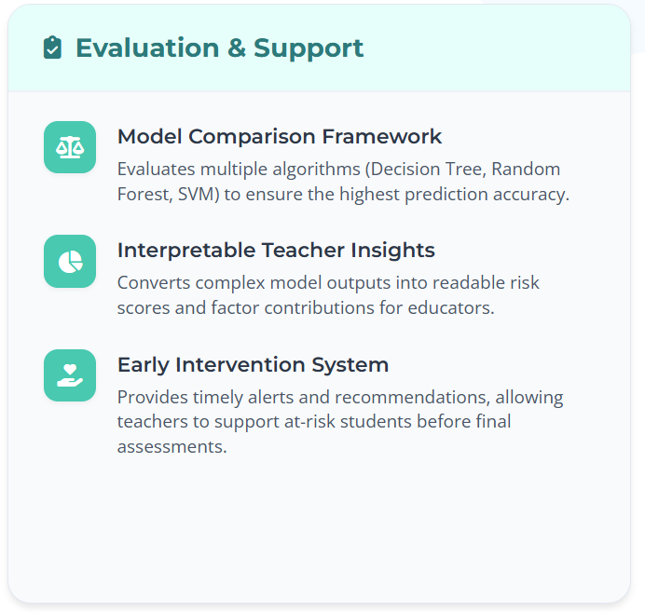
Key Features
Notes:
New Courses replaced with New Programmes

Slide 6
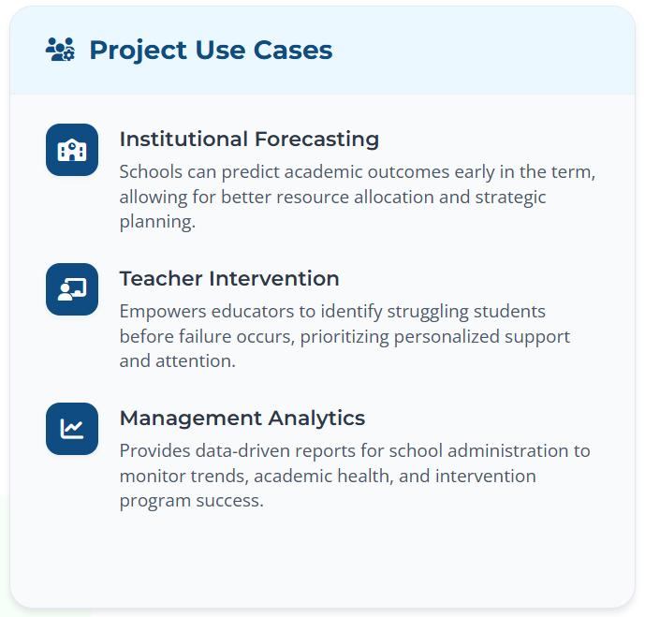
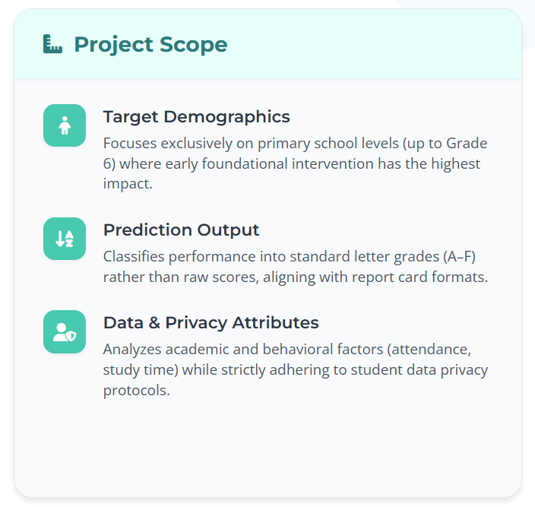
Project Usecases & Scope
Notes:
New Courses replaced with New Programmes

Slide 7
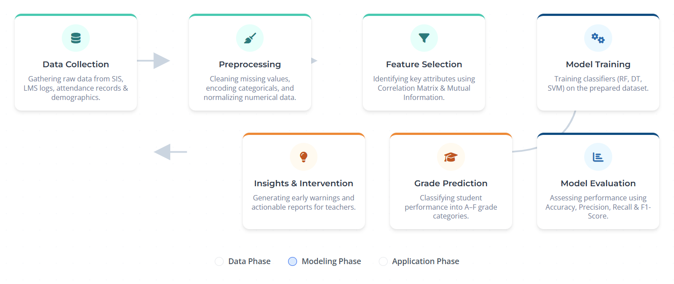
Project Flow diagram
Notes:
New Courses replaced with New Programmes

Slide 8
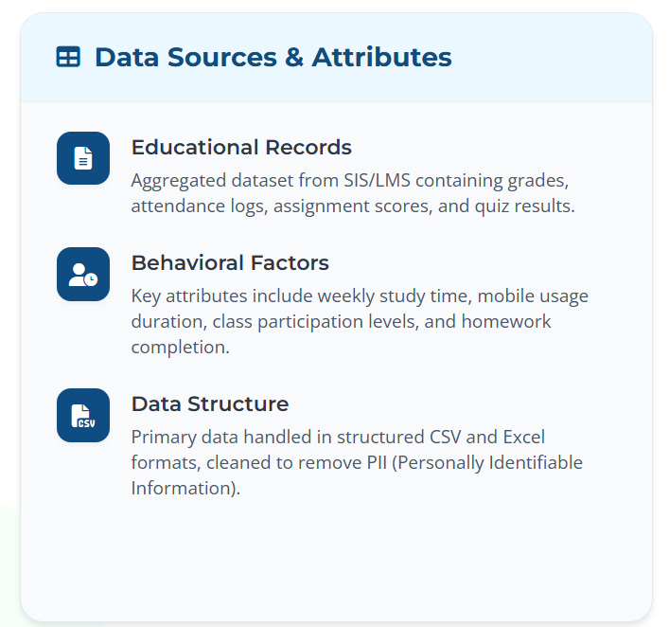
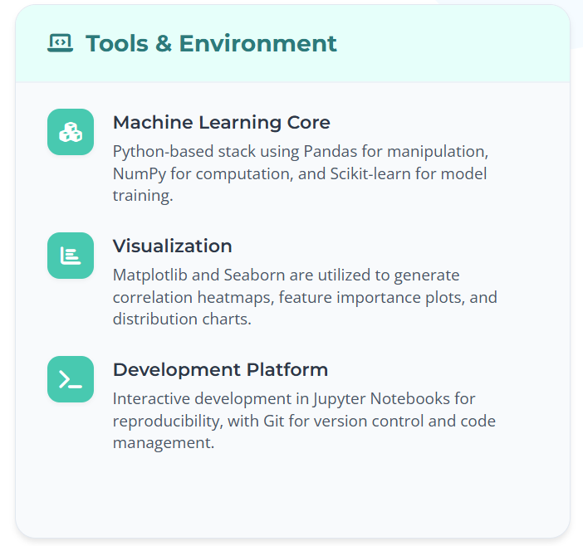
Data & Resources
Notes:
New Courses replaced with New Programmes

Slide 9
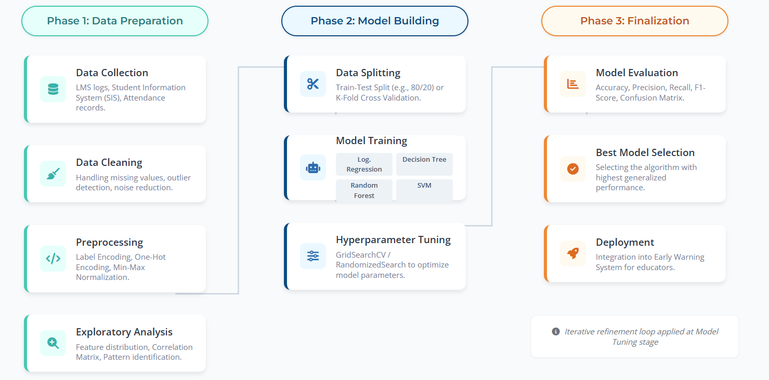
Methodology
Notes:
New Courses replaced with New Programmes

Slide 10
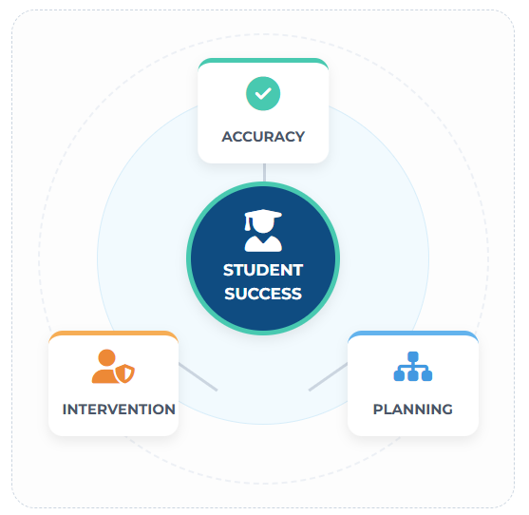
Expected Results & Impact
Accurate Grade Prediction
Achieve high classification accuracy in forecasting student grades (A–F), enabling reliable early warning systems for educators.
Risk Factor Identification
Pinpoint specific behavioral and academic factors (e.g., attendance, study habits) that most significantly contribute to performance decline.
Proactive Teacher Support
Empower teachers with actionable insights to intervene before failure occurs, shifting focus from remediation to prevention.
Data-Driven Decisions
Provide school administrators with concrete evidence to optimize resource allocation and improve institutional academic planning.
Notes:
New Courses replaced with New Programmes

Slide 11
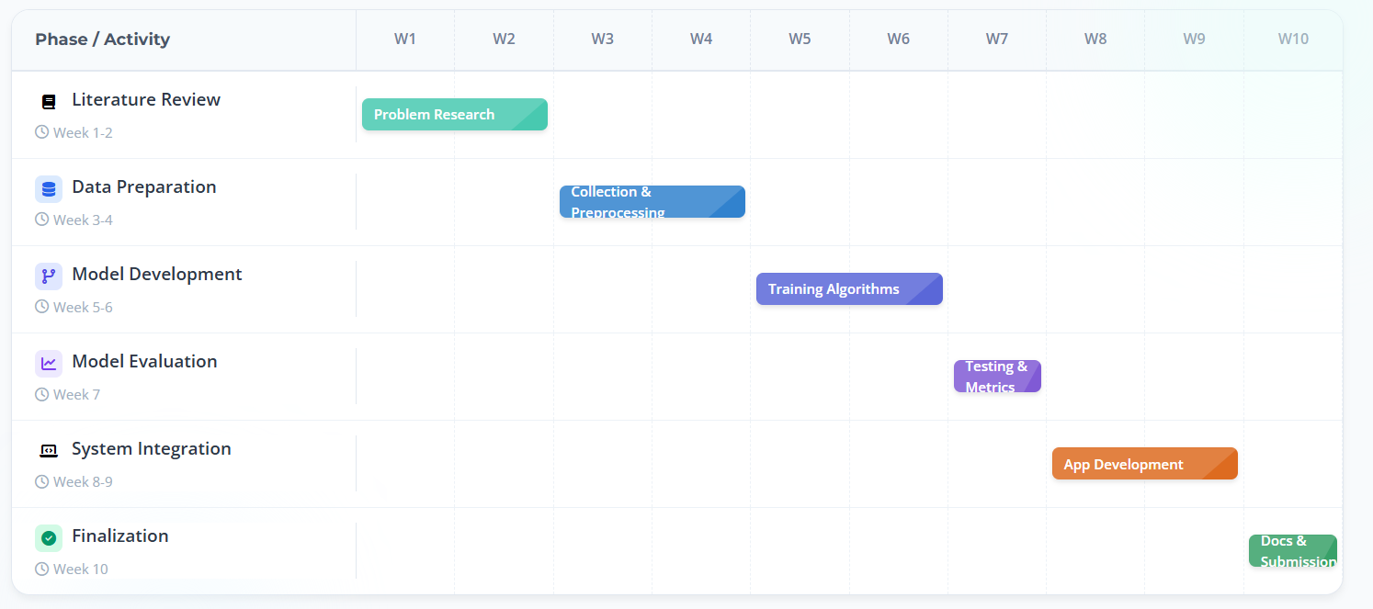
Project Timeline
Notes:
New Courses replaced with New Programmes

Slide 12
THANK YOU

